Slide 1
Linear Regression

Slide 2
Learning Goals
In this section, we will cover:
- Linear Regression
- Modeling Best Practice
- Measuring Errors

Slide 3
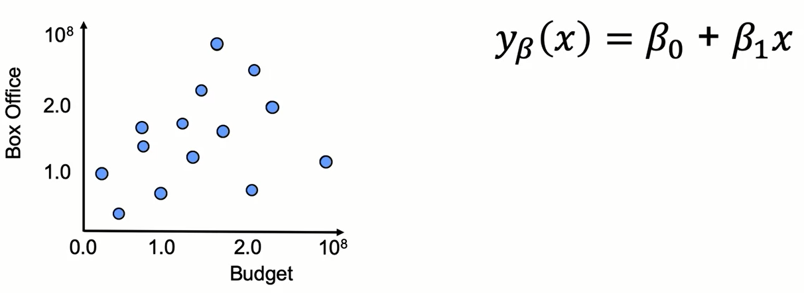
Introduction to Linear Regression

Slide 4
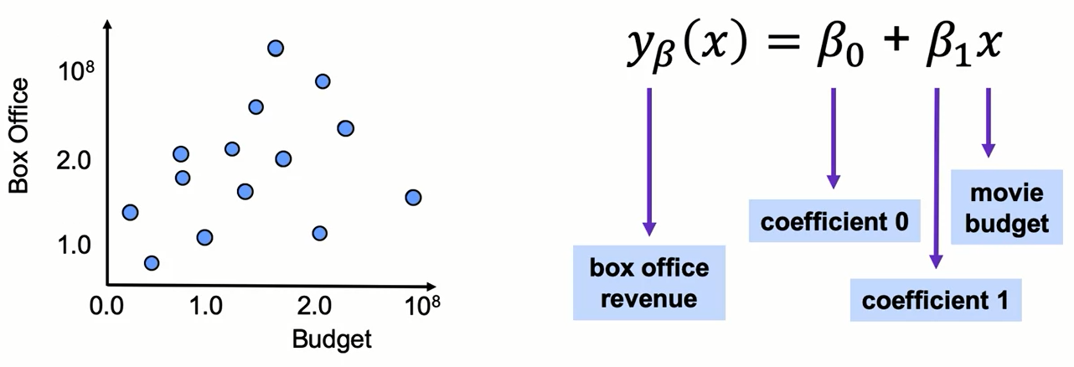
Introduction to Linear Regression

Slide 5
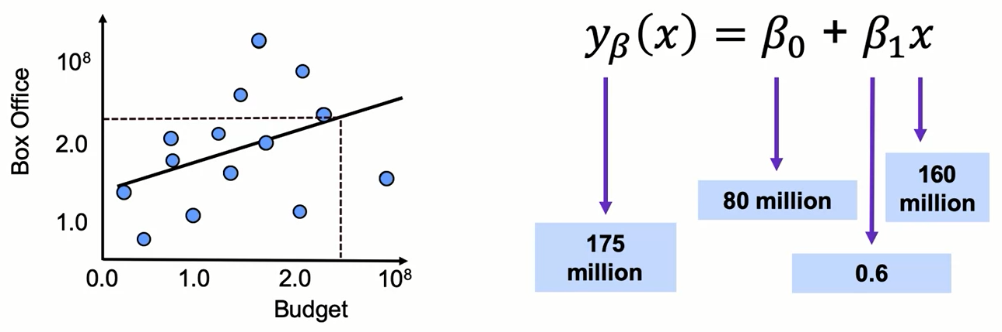
Introduction to Linear Regression

Slide 6
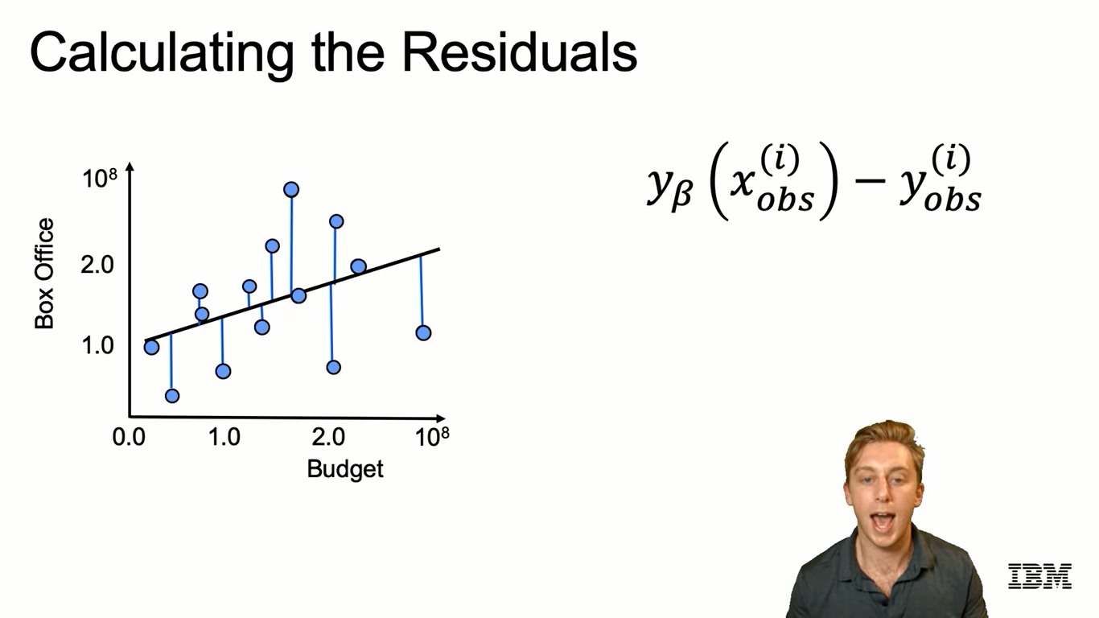
Calculating the Residuals

Slide 7
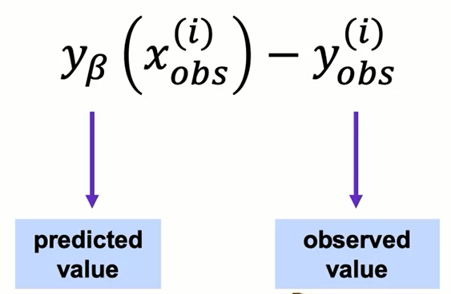
Calculating the Residuals

Slide 8
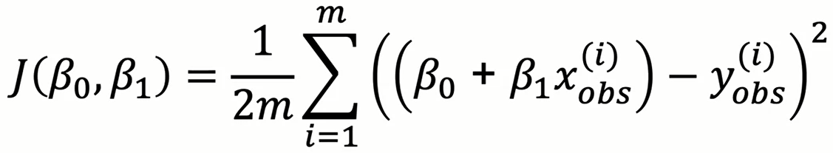
Minimizing the Error Function

Slide 9
Modeling Best Practice
- Use cost function to fit model
- Develop multiple models
- Compare results and choose best one

Slide 10
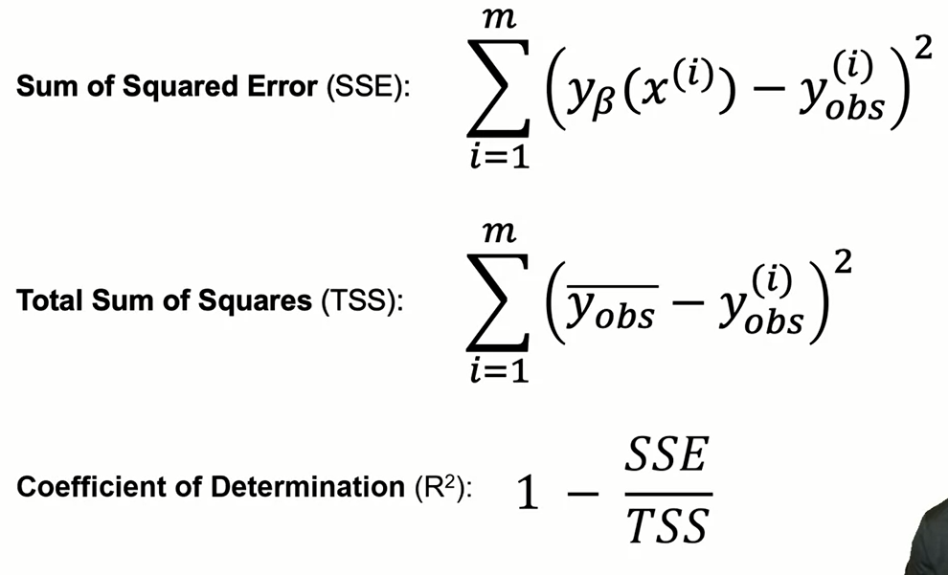
Other Measures of Error

Slide 11
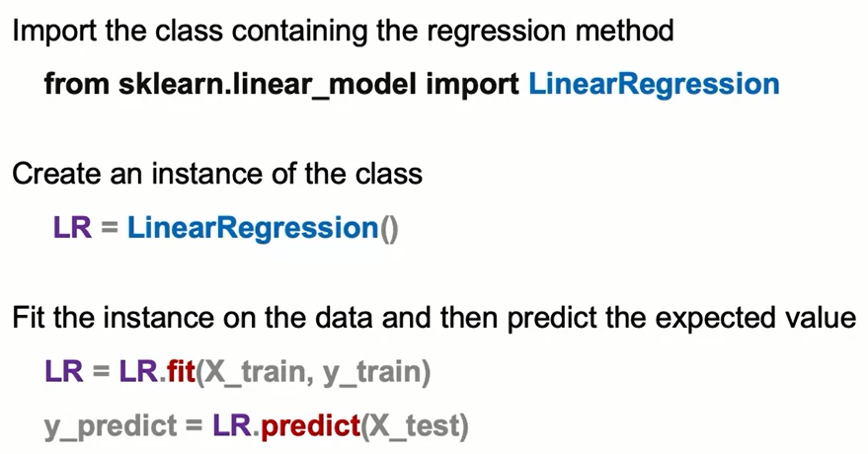
Linear Regression: The Syntax

Slide 12
Review
Linear Regression
A linear regression models the relationship between a continuous variable and one or more scaled variables. It is usually represented as a dependent function equal to the sum of a coefficient plus scaling factors times the independent variables.
Residuals are defined as the difference between an actual value and a predicted value.

Slide 13
Review
Linear Regression
A modeling best practice for linear regression is:
Use cost function to fit the linear regression model
Develop multiple models
Compare the results and choose the one that fits your data and whether you are using your model for prediction or interpretation.
Three common measures of error for linear regressions are:
Sum of squared Error (SSE)
Total Sum of Squares (TSS)
Coefficient of Determination (R2)

Slide 14
Summary
Linear Regression Syntax
The most simple syntax to train a linear regression using scikit learn is:
From sklearn.linear_model import LinearRegression
LR = LinearRegression()
LR = LR.fit(X_train, y_train)
To score a data frame X_test you would use this syntax:
y_predict = LR.predict(X_test)

Slide 15
Learning Recap
In this section, we discussed:
- Linear Regression
- Modeling Best Practice
- Measuring Errors

